Slide 1
Automatic Control Systems
Chapter 1 INTRODUCTION

Slide 2
Outlines
Basic concepts about control systems
Key mechanisms for control
History of the development of control theory
Basic information about this course
Notes:
What a control system is?
Why control systems are important?

Slide 3
Introduction
What is a system?
  A combination of components that act together and perform a certain objective. A system is not limited to physical ones. The concept can be applied to abstract.
What is a control system?
  An interconnection of components for forming a system configuration that will provide a desired response

Slide 4
Introduction
What is a plant?
  A plant may be a piece of equipment, perhaps just a set of machine parts functioning together, the purpose of which is to perform a particular operation. Generally speaking, we call any physical object to be controlled a plant
What is a process?
  A process is a natural progressively continuing operation or development marked by a series of gradual changes that succeed one another in a relatively fixed way and lead toward a particular result or end. Generally speaking, we call any operation to be controlled a process
Notes:
So, a sequence of chemical reactions can be regarded as a process. For example, if you don’t carefully control the temperature in the fermentation in liquor-making, you gonna get vinegar instead of liquor.

Slide 5
Introduction
What is a controlled variable?
  A controlled variable is the quantity or condition that is measured and controlled. Normally, the controlled variable is the output of the system.

Slide 6
Introduction
What is a manipulated variable?
  The manipulated variable is the quantity or condition that is varied by the controller so as to affect the controlled variable.
  Steering control of automobile
    Direction of the steering wheels
  Idle-speed control of automobile
    Throttle angle

Slide 7
True or False?
Question 1: can a system be an element of another bigger system?
Question 2: can a control system be an element of another bigger control system?

Slide 8
Introduction
What is control engineering?
  To find a technically feasible way to act on a given system (or process) so that the system (or process) adheres as closely as possible to some desired behavior
  Control engineering is concerned with understanding and controlling the materials and forces of nature for the benefit of humankind

Slide 9
Introduction
Benefits of improved control
  Improved product quality
  Reduced energy consumption
  Minimization of waste material
  Increased safety levels
  Reduction of pollution
  Many others
Immense!

Slide 10
Introduction
Is it easy to control a system?
Will this course teach how to control various kinds of systems?
Are there any general mechanisms for controlling systems?

Slide 11
Introduction
Limit to the systems studied in this course
  Linear systems
  Assumption of cause-effect relationship for the components of a system
Input
System
Output
Process can be represented by function blocks

Slide 12

投票
最多可选1项
Does non cause-effect system even exist in the world?
A
Yes
B
No
C
I don’t know
提交

Slide 13
Introduction
If there does exist a non cause-effect system, can anybody give me an example?

Slide 14
Introduction
Are there any general mechanisms for controlling systems?

Slide 15
Key control mechanisms
Two key mechanisms for control
  Open-loop (feed-forward)
  Utilizes an actuating devices to control the system (process) directly without using feedback (output)
Desired
output
response
Controller
Actuator
Process
Output

Slide 16
Key control mechanisms
Actuator
  A component to affect, or actuate, the system in order to move the process from the current state to a desired state
Controller
  A controller in an open-loop system is a component that turns the reference signal, according to a certain function, into some quantity or condition to drive the actuator

Slide 17
Key control mechanisms
Example of open-loop control systems
Battery
Speed
Turntable
Speed
setting
rheostat
DC amplifier
DC motor
Desired
Speed
Actual
Speed
Control device
Actuator
Plant
Amplifier
DC motor
Turntable
(Voltage)

Slide 18
Key control mechanisms
Two key mechanisms for control
  Closed-loop (feedback)
  Uses a measurement of the output and feedback of this signal to compare it with the desired input (reference or command)
Output
Comparison
Amplifier
Actuator
Process
Desired
output
response
Sensor

Slide 19
Key control mechanisms
Sensor
Sensors are the eyes of control enabling one to see what is going on

Slide 20
Key control mechanisms
Controller
A controller is the brain of control engineering i.e. the algorithms that coordinate the sensors and the actuators

Slide 21





Key control mechanisms
Better Sensors
Provide better Vision
Better Actuators
Provide more Muscle
Better Control
Provides more finesse by combining sensors and
actuators in more intelligent ways
Notes:
Figure of speech

Slide 22
Key control mechanisms
Example of closed-loop control systems
Battery
Speed
Turntable
Speed
setting
Rheostat
DC motor
+
DC amplifier
-
Tachometer

Slide 23
Key control mechanisms
Desired
Speed
Actual
Speed
+
Control device
Actuator
Process
Amplifier
DC motor
Turntable
(Voltage)
-
Measured speed
(Voltage)
Sensor
Tachometer
Notes:
Negative and positive feedback

Slide 24
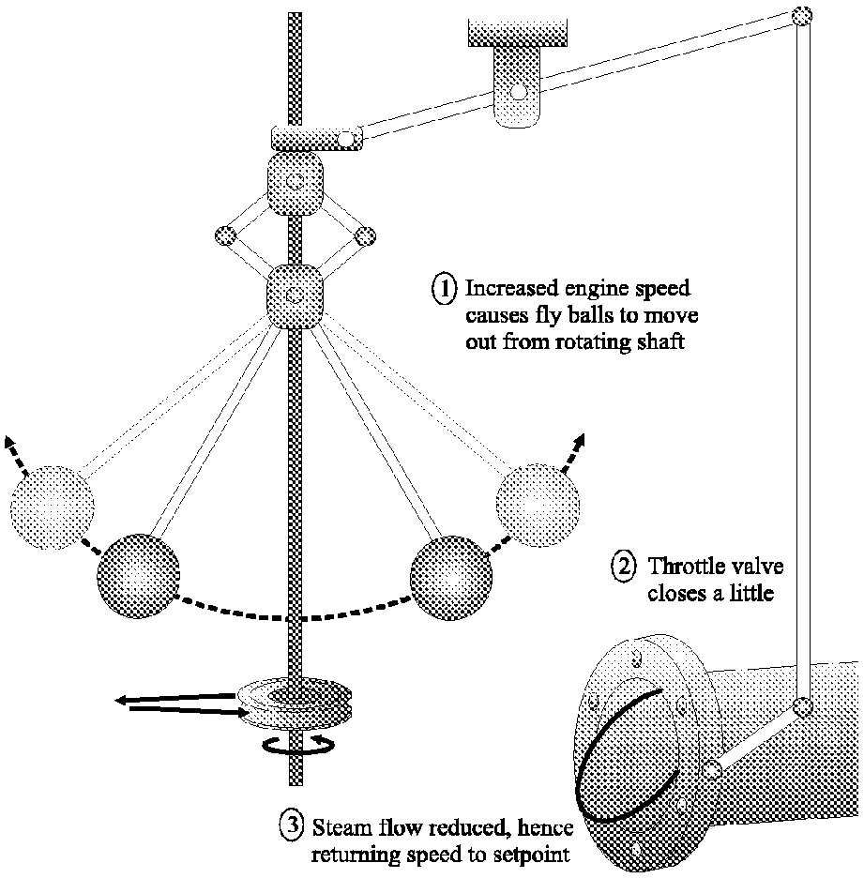
Key control mechanisms
fixed fulcrum
Another example of feedback control
  Fly-ball governor
fixed fulcrum
Centrifugal force
Notes:
Centripetal force
Centrifugal force
Water vapor
Fulcrum of a lever

Slide 25
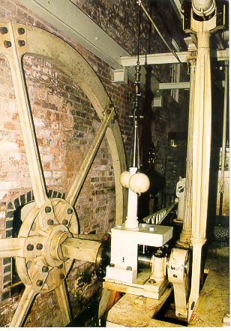
Key control mechanisms
This photograph shows a fly- ball governor used on a steam engine in a cotton factory near Manchester in the United Kingdom.
Of course, Manchester was at the centre of the industrial revolution. Actually, this cotton factory is still running today.

Slide 26
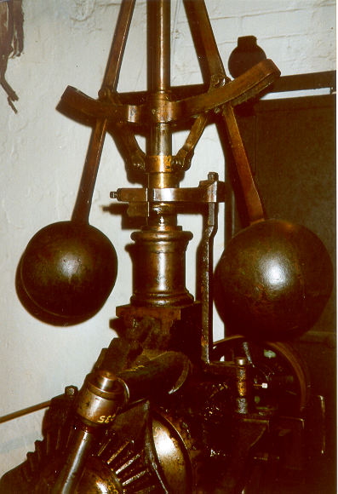
Key control mechanisms
This fly-ball governor is in the
same cotton factory in Manchester. However, this particular governor was used to regulate the speed of a water wheel driven by the flow of the river.
The governor is quite large as can be gauged by the outline of the door frame behind the governor.
Notes:
calibrate

Slide 27
Question: Can any of you give me an example of an open-loop control system or a closed-loop control system?

Slide 28
Question: Do you think that the closed-loop control is better than open-loop control?

Slide 29
Complex control systems
Boiler
Turbine
Output
Electric Power
Water
feed
Valve
High Pressure
Steam Gas
Valve
Shaft
Fuel
Generator
Valve
air
Control Variable
Speed
Governor
Desired Working
State
O₂ Meas.
T Meas.
Pressure
Tachometer
Volt. Curr.
Controller
Desired Output
Electric Power
Coordinated control system for a boiler-generator

Slide 30
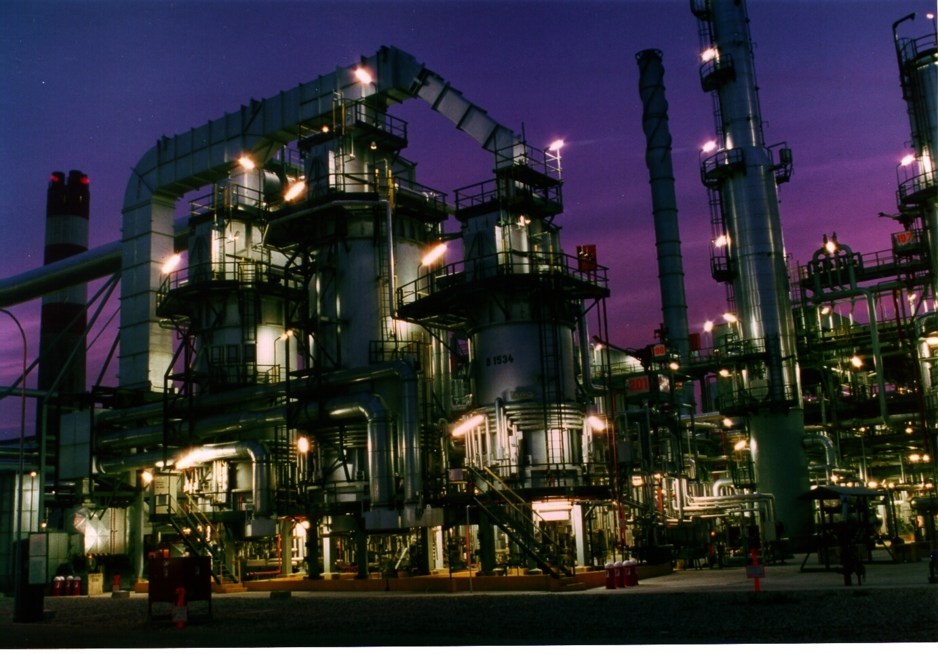
Complex control systems
A section of an oil refinery plant

Slide 31
Complex control systems
Output
Input
Controller
Process
(System)
feedback
Measurement
A section of an oil refinery plant

Slide 32
Exercise
The following is a water-level control system. Please:
Describe how it works
Point out the controlled variable and the reference
Draw the function blocks of the control system
Lever
Valve
Float ball
Feed in water
h
Water
Water level
Flow out water
We need a volunteer to sketch the function blocks on the board.

Slide 33
Exercise
desired
water-level
＋
error
water-level
lever
valve
－
water-level
floating ball

Slide 34
Historical periods of control theory
Industrial revolution
  Feedback controllers began to be widely used
  The first automatic feedback controller used in an industrial process is generally agreed to the fly-ball governor
  Foundation: intuition and invention
  Towards rigorous analysis – Ordinary Differential Equations (ODE)

Slide 35
Historical periods of control theory
The Second World War
  Objectives: stabilizing control systems
  Foundation: transfer function, graphical means (frequency domain method) such as Bode Plot & Nyquist plot
  Limit: single-input single-out system
  Generally known by the generic term – Classic Control Theory

Slide 36
Historical periods of control theory
The Push into space in the Cold War
  Objectives: complex and sophisticated control, realizing optimal control
  Foundation: state space approach (time domain method)
  Advantage: multi-input multi-out system
  This set of development is loosely termed – Modern Control Theory

Slide 37
Historical periods of control theory
The economic globalization, shareholder –value thinking
  Objectives: including the effect of disturbances and uncertainty
  Foundation: L₂ gain and H-infinity Norm
  This can be classified as the period of – Robust Control Theory

Slide 38
Historical periods of control theory
Disturbances and Uncertainty
  all real life systems are acted on by noise and external disturbances. These factors can have a significant impact on the performance of the system.
  As a simple example, aircraft are subject to disturbances in the form of wind-gusts, and cruise controllers in cars have to cope with different road gradients and different car loadings.

Slide 39
Historical periods of control theory
Parallel researches
  Nonlinear control
  Intelligent control
  Adaptive control

Slide 40
What will we learn from this course?
Master basic concepts and methods of Classic Control Theory
  Transfer function
  Frequency domain analysis and synthesis method
Grasp basic principles of Modern Control Theory
  State Space analysis method

Slide 41
What will we learn from this course?
Basic analysis approaches for digital control systems
Learn how to use simulation software – Matlab
Learn the local simulation platform - CloudPSS

Slide 42
How to learn in this course?
Pay attention in class
Finish assignments after class
Think all the time and think independently

Slide 43
How to earn your score?
From Assignments (14%)
From quizzes (16%)
Comprehensive training (10%)
Final Examination (60%)

Slide 44
How to earn your score?
How to apply for waiver of final exam?
  Submit one of your works in control area (SRT report)
  Pass the face-to-face interview

Slide 45
Contact of the teacher
Chen Shen (沈沉)
  Tel: 62796516
  Email : shenchen@tsinghua.edu.cn
  Office: Room 3-105, West Main Building

Slide 46
References
Benjamin C. Kuo, Automatic Control Systems, ninth edition
苏鹏声，焦连伟， 《自动控制原理》 (第二版)，电子工业出版社，2011年
Richard C. DorF, Robert H. Bishop, Modern Control Systems, eighth edition
Granham C. Goodwin, Stefan F. Graebe, Mario E. Salgado, Control System Design

Slide 47
Chapter 2
Mathematical Models of Systems

Slide 48
Review
Basic concepts about control systems
Key mechanisms for control
History of the development of control theory
Basic information about this course

Slide 49
Outlines
Basics about LTI systems
Linearization of a nonlinear system
Linear system modeling
Laplace transformation
Transfer function of a linear system

Slide 50


Linear and Stationary Dynamic Systems
A system is defined as linear in terms of the system excitation and response
Excitation
Response
Linear System
Necessary conditions for a linear system
  Principle of superposition
  Property of homogeneity

Slide 51


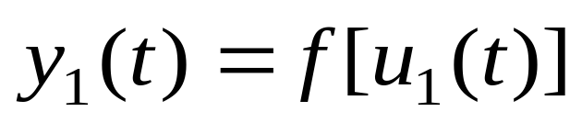
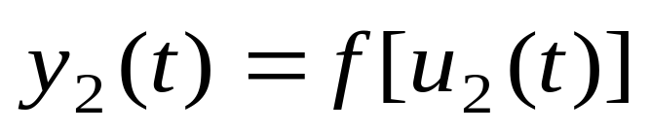
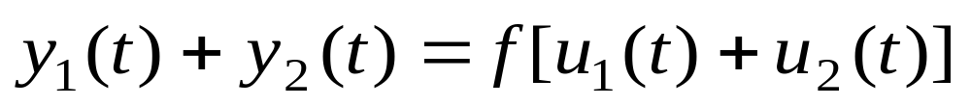
Linear and Stationary Dynamic Systems
Excitation
Response
Linear System
Principle of superposition

Slide 52


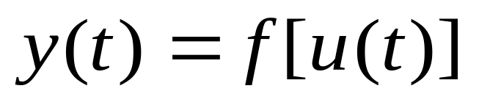
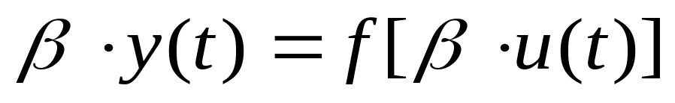
Linear and Stationary Dynamic Systems
Excitation
Response
Linear System
Property of homogeneity

Slide 53
Question: Are the two principles equivalent?
How to prove equivalence?

Slide 54
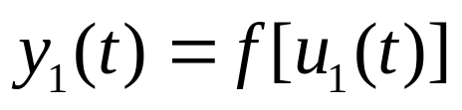
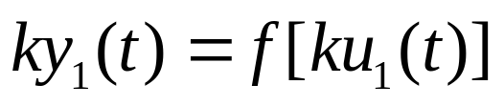
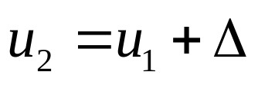
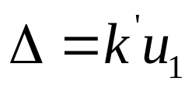
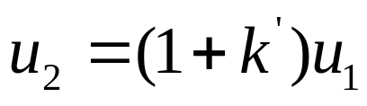
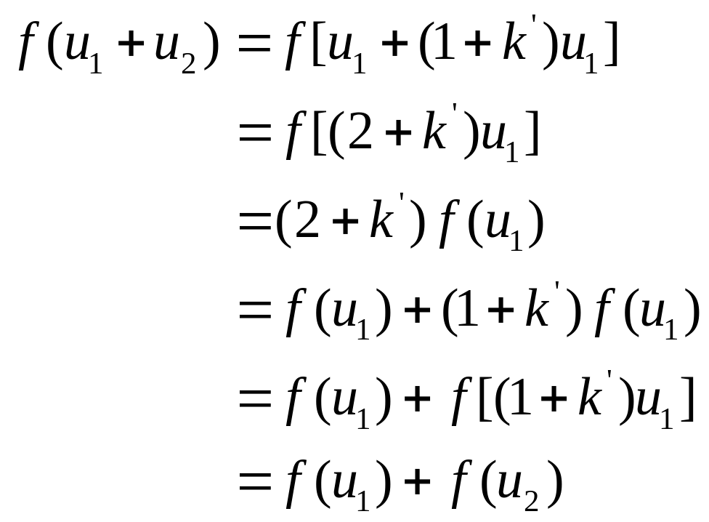
Homogeneity
Superposition
If
Set
So

Slide 55

1. How about the variables are vectors or matrices?
2. How to prove from superposition to homogeneity?

Slide 56
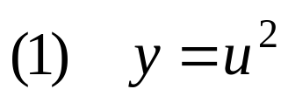
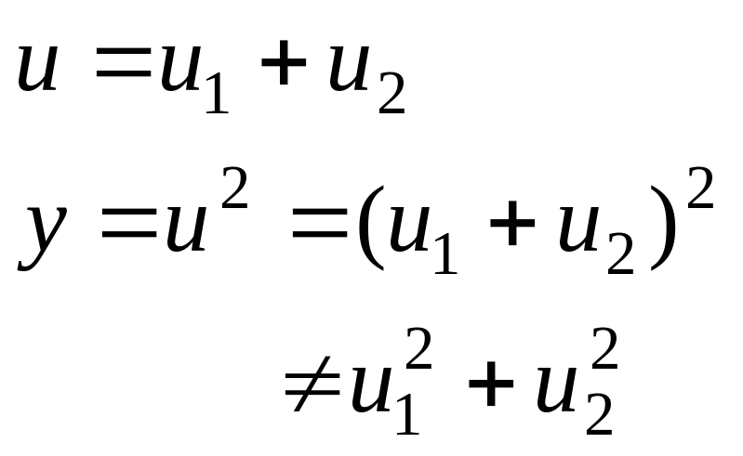
Linear and Stationary Dynamic Systems
Questions: are the following systems linear?
Answers:

Slide 57
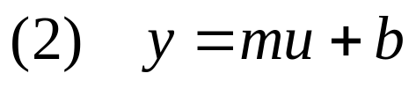
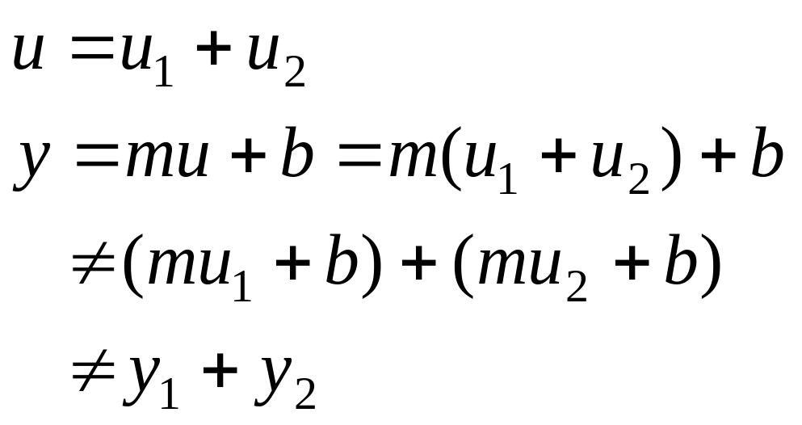
Linear and Stationary Dynamic Systems
m and b are constant parameters
Answers:

Slide 58




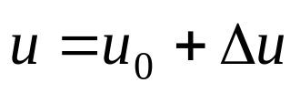
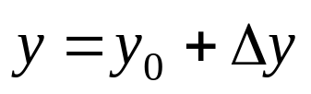
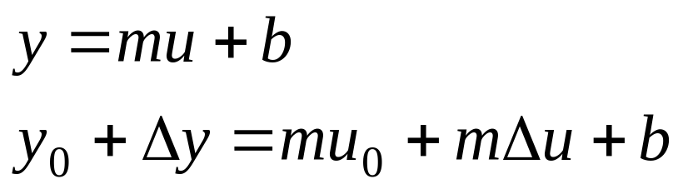
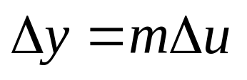
Linear and Stationary Dynamic Systems
第<number>页
System (2) can be considered as a linear one about an operating point , for small changes and . when and , we have
Therefore

Slide 59
Linear and Stationary Dynamic Systems
Coordinates Shift
y
y=mu+b
(u₀,y₀)
u

Slide 60
Linearization of Nonlinear Dynamic Systems
Most of the physical systems, if not all, are nonlinear
One can often linearize nonlinear elements assuming small-signal conditions
Taylor series expansion about the operation point can be utilized

Slide 61

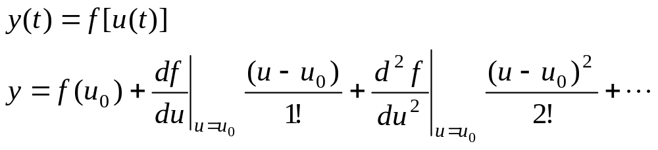
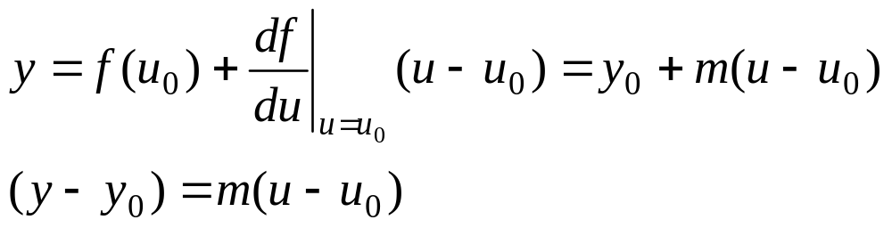
An Example of Linearization
A nonlinear system
Taylor series expansion
The slope at the operating point is a good approximation to the curve over a small range of (u-u₀)
Notes:
n! : factorial

Slide 62
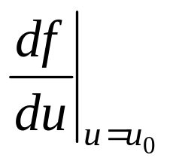
An Example of Linearization
y
y₀
Equilibrium
(Operating Point)
u
u₀

Slide 63
Mathematical Models of Physical Systems
Quantitative mathematical model are necessary for solving control problems
Physical systems are dynamic in nature – differential equations
Linear time invariable systems - ODE

Slide 64
How to model a physical system
Define the system and its components
Formulate the mathematical models of components and list the necessary assumptions
Write the differential equations that describe the dynamics of models according to physic laws
Solve the equations for the desired output variables
Examine the solutions and the assumptions
If necessary, reanalyze the system

Slide 65

Example 1
Assumption 1: linear spring
Assumption 2: viscous damper (not coulomb)
Physic law: Newton’s second motion law
k
Wall friction, b
Mass
M
Distance, y(t)
Force, r(t)
Notes:
elastic factor
gravity
acceleration

Slide 66
How to solve an ODE
Laplace transform method converts a problem of solving an ordinary differential equation (ODE) into a relatively easier problem of solving an algebraic equation:
  Obtain the differential equations
  Calculate the Laplace transformation
  Solve the resulting algebraic transform
  Get the time response by inverse Laplace transform

Slide 67
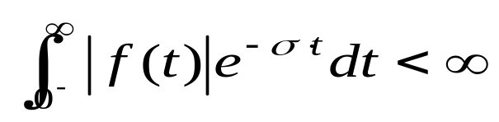
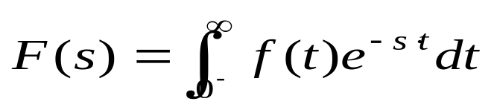
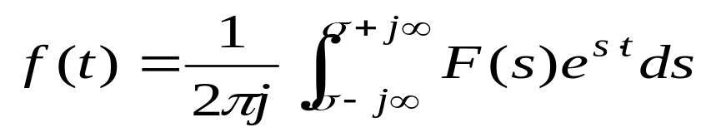
Laplace Transform
Sufficient condition for Laplace transformation existence
Physically realizable signals always have a Laplace transform
Laplace transform is written as
Inverse Laplace transform is written as

Slide 68
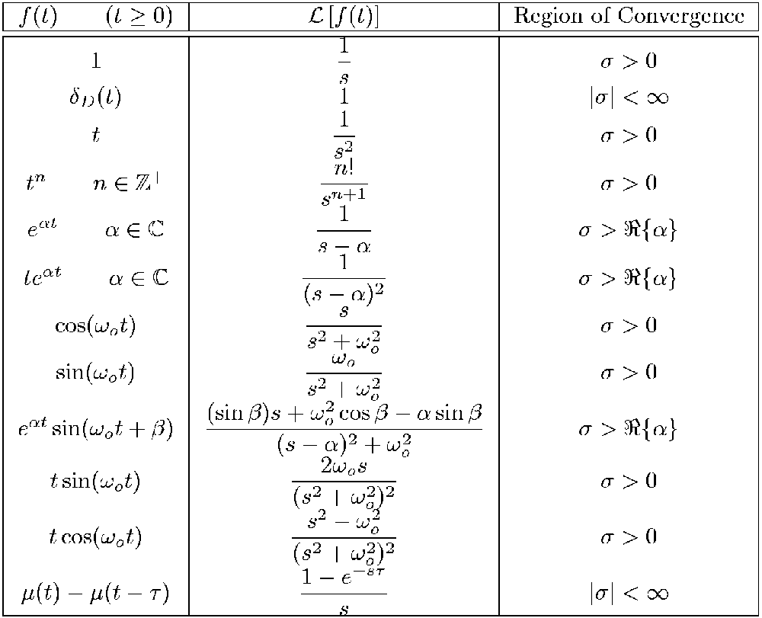
Important Laplace Transform Pairs

Slide 69
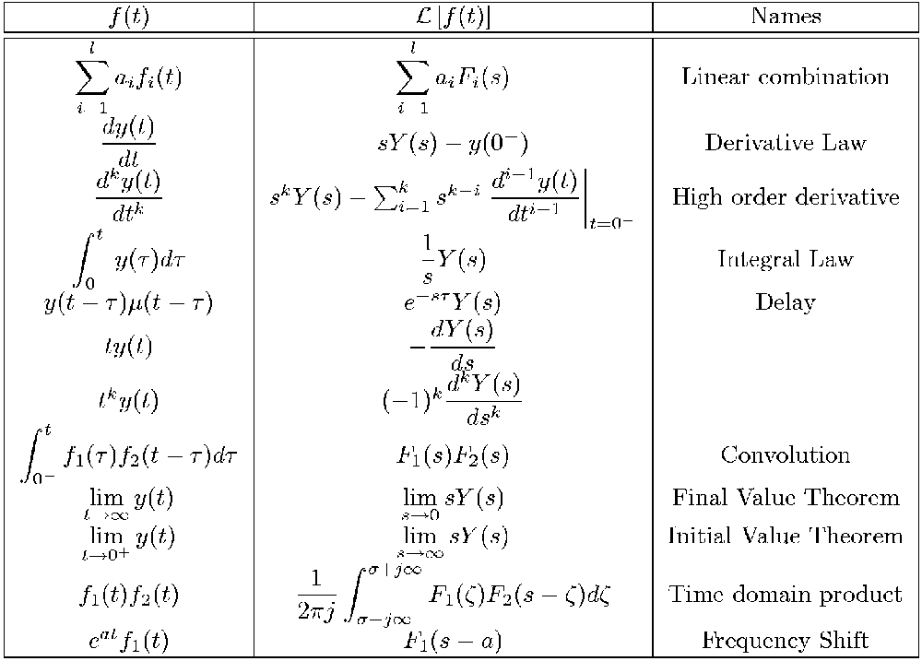
Important Laplace Transform Pairs

Slide 70
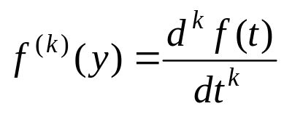
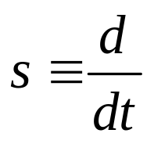

Important laws
Derivative law
Original function:
Laplace transform:
Laplace variable s can be considered to be the differential operator
so long as

Slide 71
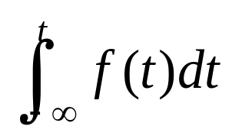
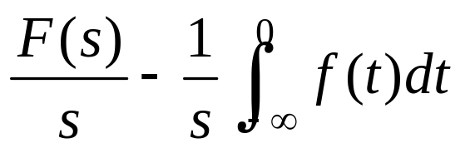
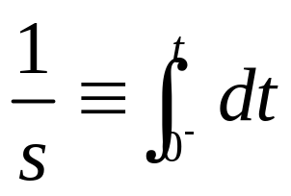
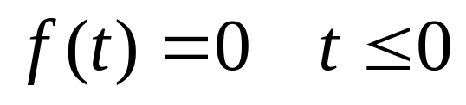
Important laws
Integral law
Original function:
Laplace transform:
1/s can be considered to be the integral operator
so long as

Slide 72






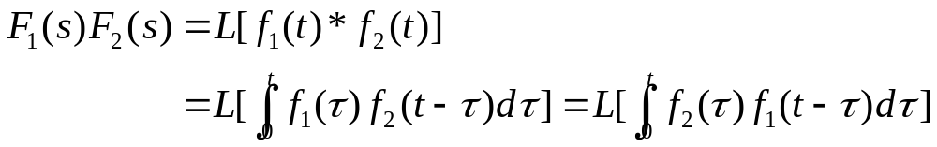
Important laws
Real Convolution (Complex Multiplication)
Let
and
be the Laplace transforms of
and
,
respectively, and
, for
; then

Slide 73
The Transfer Function
The transfer function of a linear system is defined as the ratio of the Laplace transform of the output variable to the Laplace transform of the input variable with all initial conditions assumed to be zero
L (output)
TF =
L (input)

Slide 74
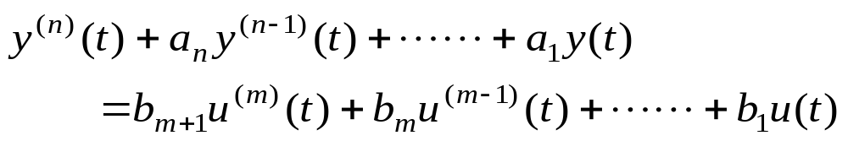


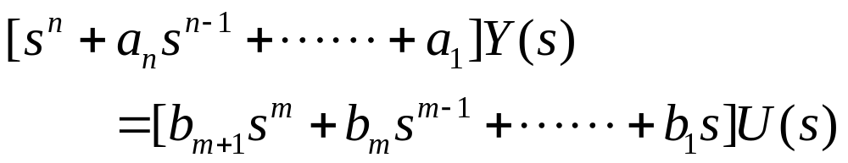
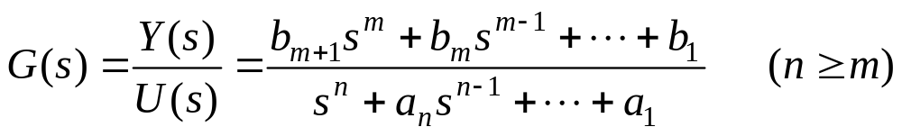
ODE to Transfer function
Origin system
Zero initial condition
Laplace transform
Transfer function

Slide 75
Remarks
The transfer function is defined only for linear time-invariant systems
All initial conditions of the system are set to ZERO
The transfer function is independent of the input of the system
The difference between n and m is call the relative degree of the system. The transfer function is said to be strictly proper if n>m.

Slide 76







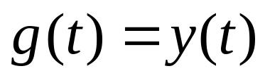

Another Definition of TF
G(s)
Laplace transform
Input:
output:
Unit impulse response:
set:
when

Slide 77
Wrap-up
Basics about LTI systems
Linearization of a nonlinear system
Linear system modeling
Laplace transformation
Transfer function of a linear system

Slide 78
Assignment
Find an automatic control system in world-wide history which is earlier than the fly-ball governor, and describe how it works using function blocks.
Please hand in your assignment every two weeks!
Time: the last Sunday of the second week.
Please put your assignment in my mailbox
in Room 3-119, West Main Building

